Slide 1


BMI MANAGEMENT CALCULATOR

Slide 2

TEACHER BY
MD. SOLAIMAN MIA
ASSISTANT PROFESSOR AND ASSISTANT DIRECTOR OF STUDENT AFFAIRS FOR
GREEN UNIIVERSITY OF BANGLADESH
PRESENTED BY
MIM AKTER 222002104
AND
SAIFULLA TANIM 222002014

Slide 3


TABLE OF CONTENTS
Introduction
Switch Case
Objectives
Loop
Flowchart
Array
Technologies Used
Function
If-Else
Conclusion

Slide 4

OBJECTIVE
To calculate BMI, interpret results, and store user data interactively.
Features:
Input weight and height.
Automatic BMI calculation.
Health interpretation based on BMI.
User data storage and display.

Slide 5
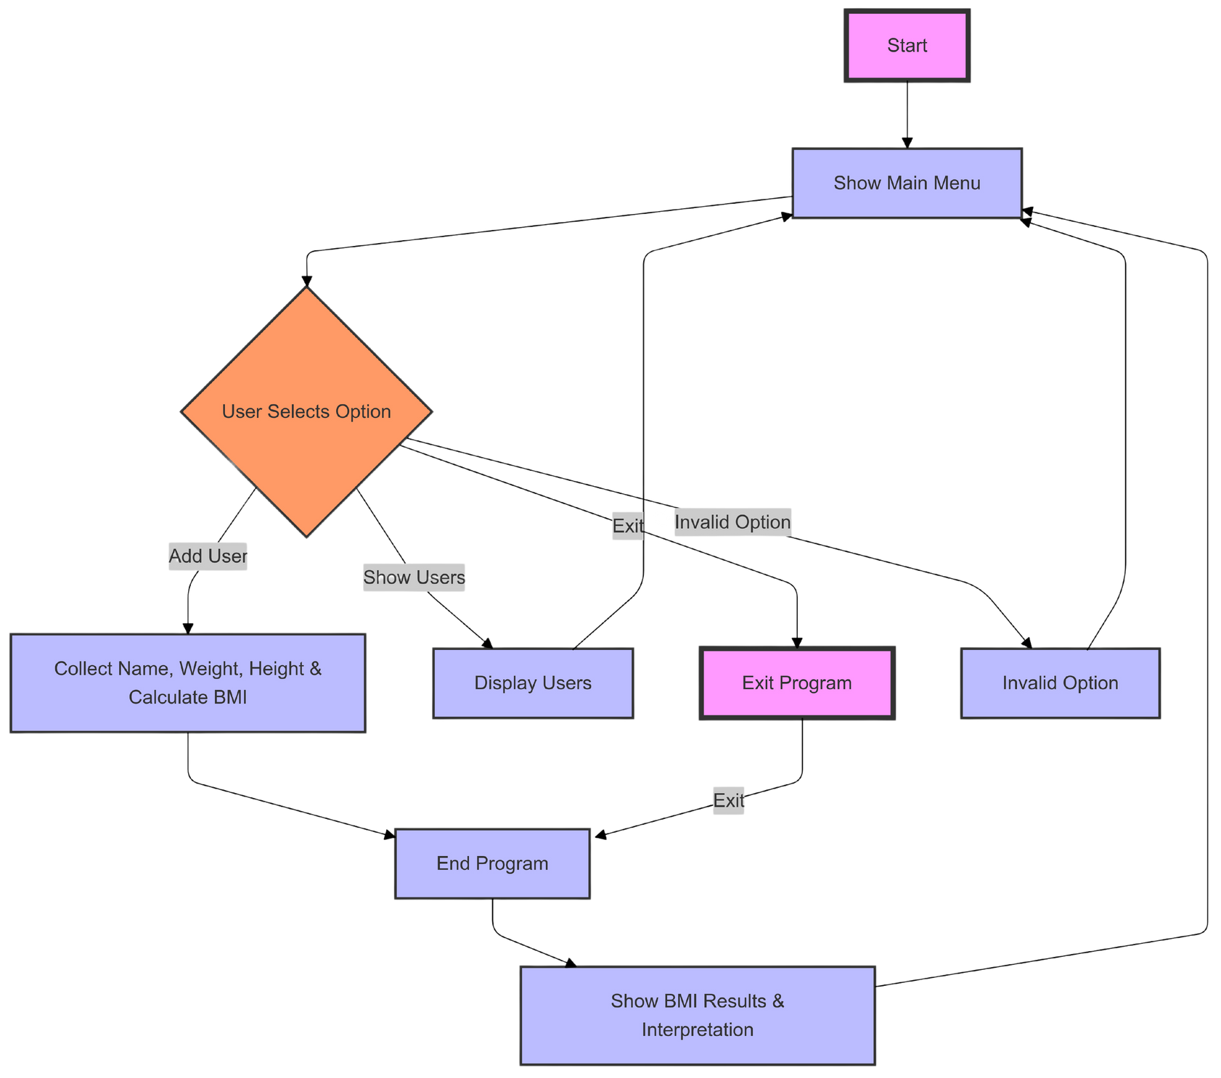

FLOWCHART

Slide 6


TECHNOLOGIES USED
DIALOG
bc
FOR INTERACTIVE USER INTERFACE
FOR ARITHMETIC OPERATIONS.

Slide 7
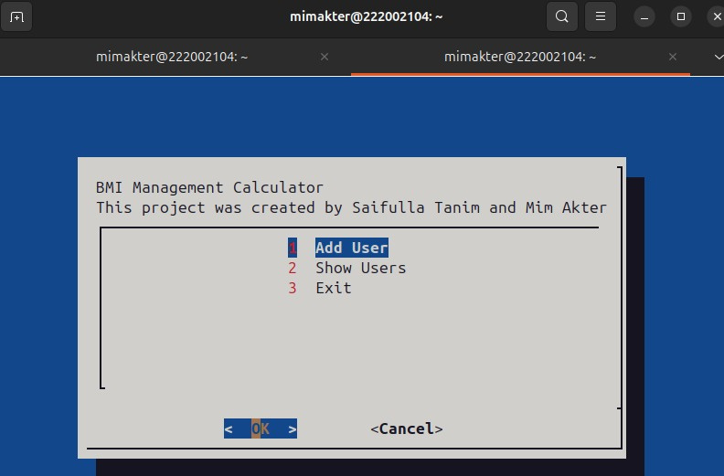
IMPLEMENTATION OVERVIEW

Slide 8
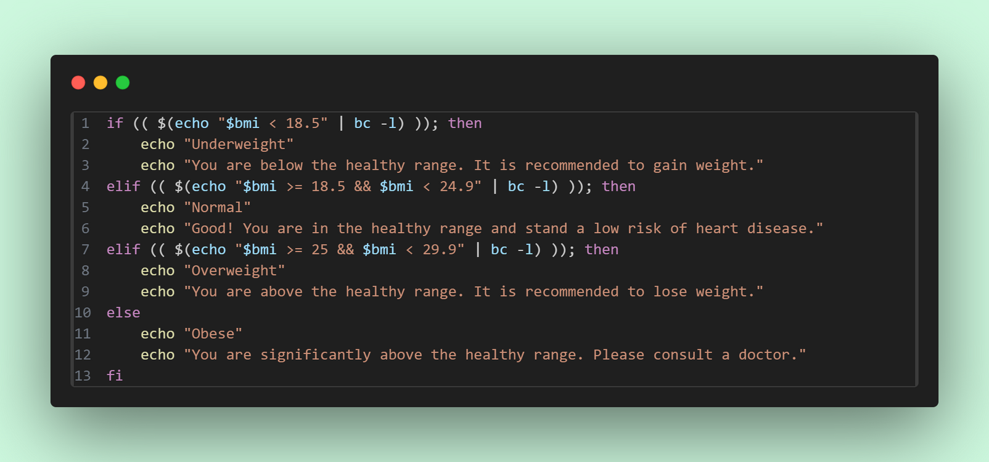
IF-ELSE

Slide 9
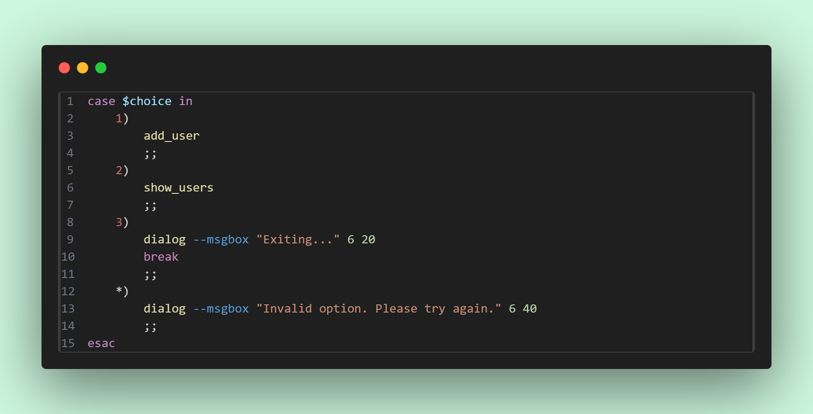
SWITCH CASE

Slide 10
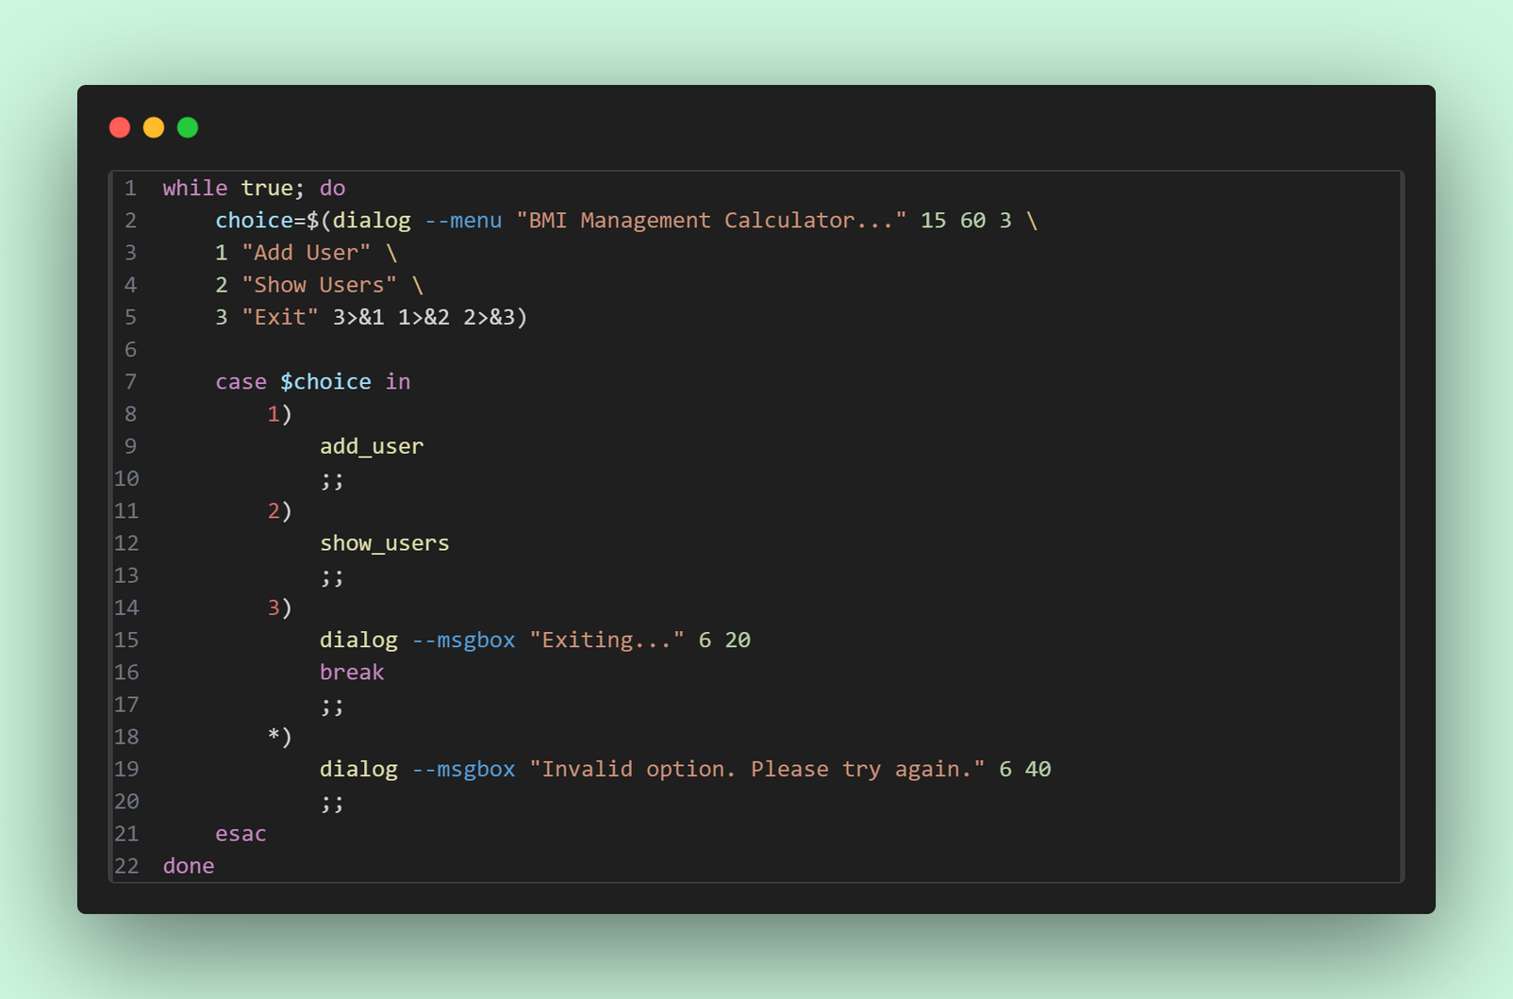
LOOP

Slide 11
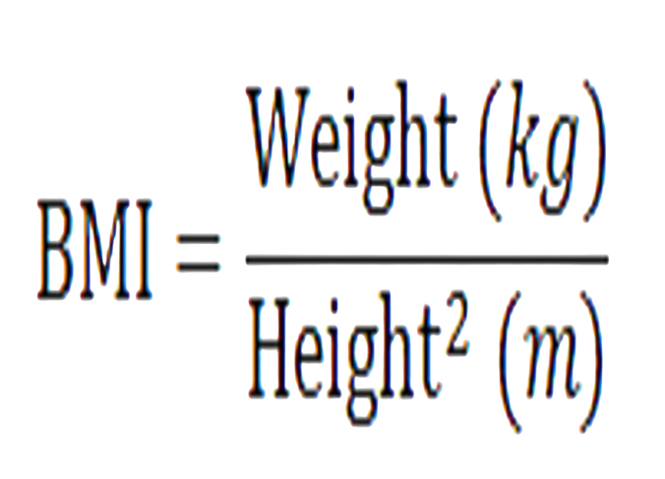
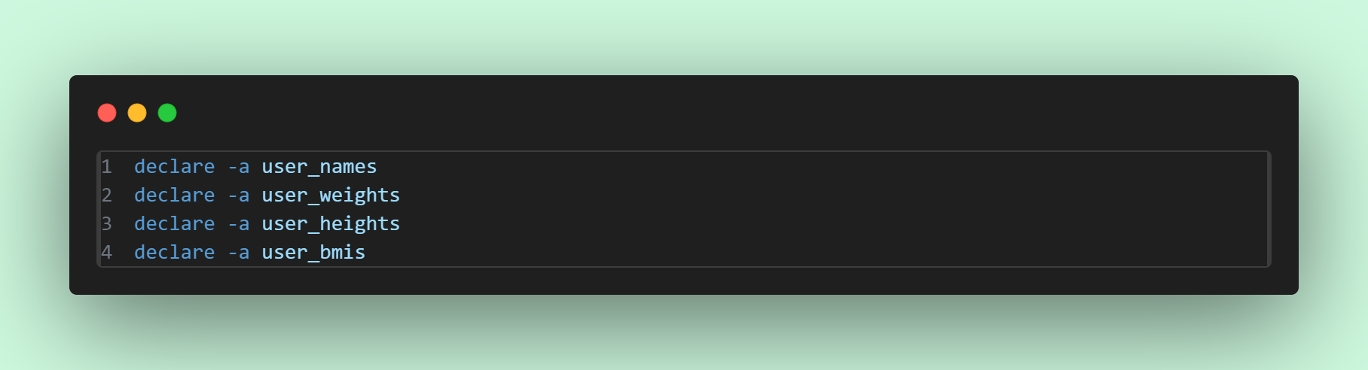
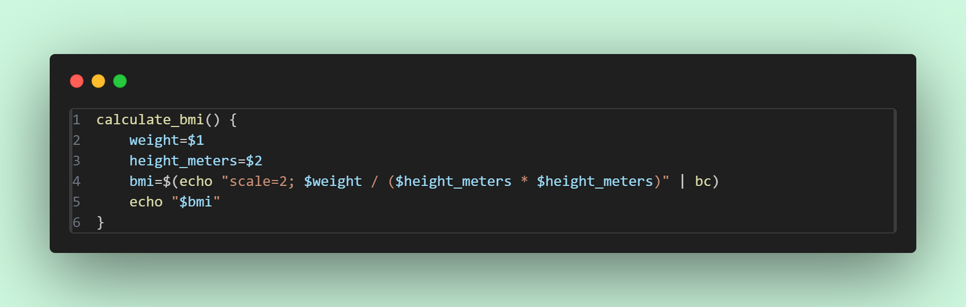
FUNCTION
ARRAY

Slide 12

Future Work
Advanced User Analytics
Integration with Health APIs
User Authentication
Graphical User Interface
Multi-language Support
Mobile and Cloud Support

Slide 13

CONCLUSION
IN CONCLUSION, OUR BMI MANAGEMENT CALCULATOR ACHIEVES ITS GOAL OF PROVIDING AN INTERACTIVE AND EFFICIENT HEALTH MANAGEMENT TOOL. FUTURE ENHANCEMENTS COULD INCLUDE EDITING OR DELETING ENTRIES AND ADDING GRAPHICAL TRENDS.

Slide 14


